Slide 1
Business Process Engineering
Sobia Iftikhar

Slide 2
Public vs. Private Processes
Often multiple agencies (organisations, companies) cooperate, e.g.
Classical purchasing scenarios with customer, retailer and transporter
Partnership where different partners with their resources and know how contribute to a service or product
In this case we can distinguish between public and private processes
Public Process: coordinates work between partners
describes the inter-organisational cooperation
internal processes of the partners are treated as "black boxes"
Specifies the information and objects that are exchanges between partners
Private Process: Process within one organisation
Destailed process flow for each partner

Slide 3
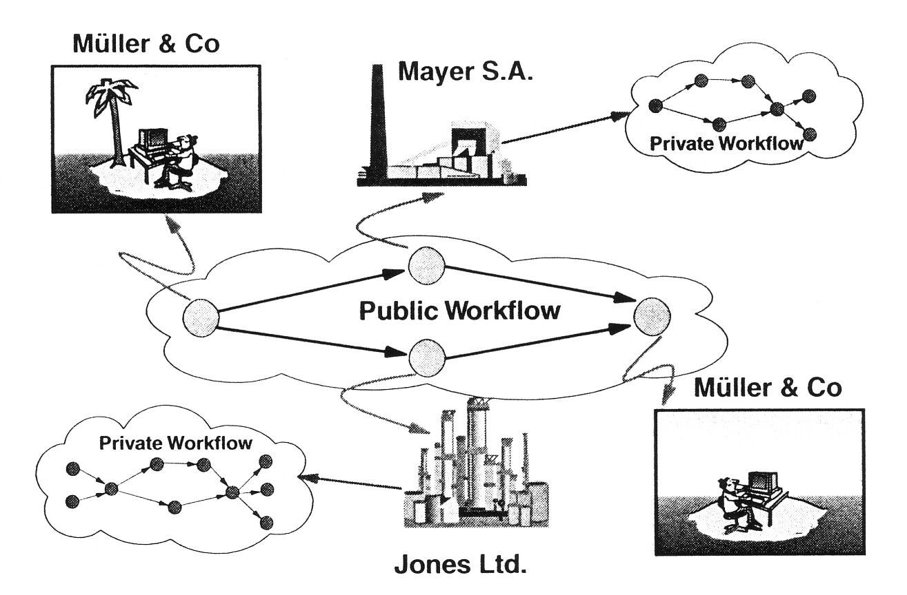
Public and Private Processes

Slide 4
Private and Public Processes in BPMN
BPMN uses Pools when representing the interaction between an organisations and participants outside of its control.
Each participant operates a separate process represented by pools.
Within a company, a single pool covers its own internal operations. It is only when it interacts with external participants that additional pools are required.
Message Flow cannot communicate between Tasks inside a single Pool. This is what Sequence Flow and data flow does.
Message Flow moves the Process from one agency to another.

Slide 5
Orchestration, Choreography, and Collaboration
BPMN supports three main categories of Processes:
Orchestration
Choreography
Collaboration
Orchestration models imply a single coordinating point of view. An orchestration Process describes a process within a single business entity.
An orchestration is contained within a Pool and normally has a well-formed context.
A choreography process model is a definition of the behavior between interacting
participants.
A choreography does not exist within a well-formed context or focus of control.
There is no central mechanism that drives or keeps track of a choreography. Therefore, there are no shared data available to all the elements of the choreography.
To place choreography within BPMN diagrams is to put them between the Pools.
Collaboration shows the participants and their interactions
In BPMN a collaboration only shows Pools and the message flow between them
(White & Miers 2008, pp. 29ff)

Slide 6
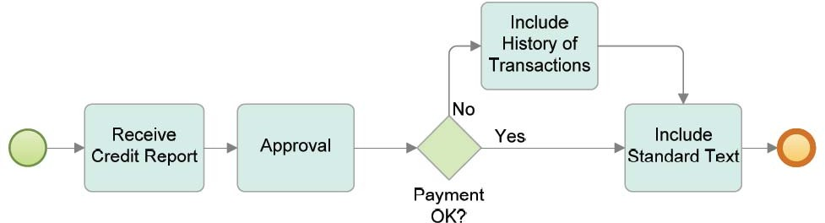
Orchestration in BPMN
A BPMN diagram may contain more than one orchestration. If so, each orchestration appears within its own container called a Pool. Thus, orchestrations (i.e., Processes) are always contained within a Pool.
(White & Miers 2008, p. 29)

Slide 7
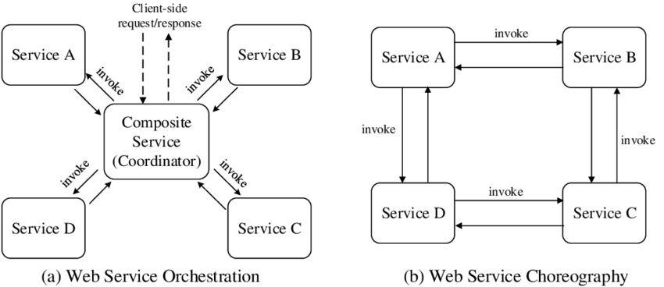
process orchestration vs choreography
The term Process Conversation refers to the concrete messages that are ex-changed as specified in a given process choreography. Therefore, process choreographies serve as conversation models.

Slide 8
Process Choreography
Choreographies have a central role in ensuring interoperability between process orchestrations.
It is performed by a participant in a business-to-business collaboration.
Several industry initiatives are in place for establishing standardized choreographies in particular domains.
Examples: include RosettaNet for the supply chain domain, SWIFTNet for financial services, and Health Level Seven (HL7) for health care services.
They all define rules for the collaboration that companies need to comply with in order to collaborate with each other.

Slide 9
Process Choreography
By introducing collaboration rules, costs for the individual companies are reduced.
New companies can join the market more easily, since they know the rules of that domain.
These collaboration rules are specified by process choreographies.

Slide 10
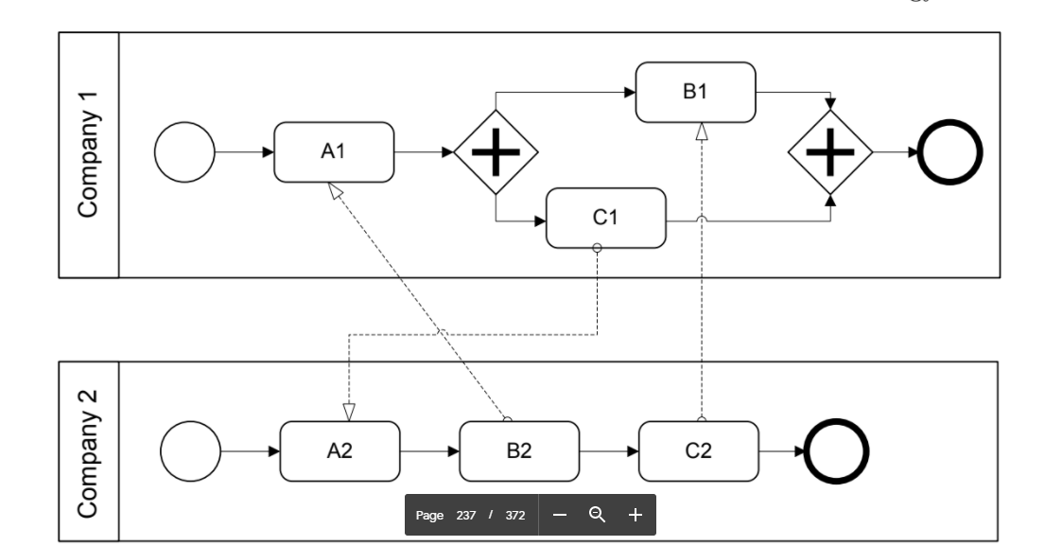
Process Choreography
The first activity to be performed by Company 1 is receive activity A1.This activity waits to receive a message sent by activity B2. the receive activity A1 is blocking, the process orchestration run by Company 1 cannot proceed. Company 2 waits in activity A2 to receive a message from activity C1 to be sent by Company 1. As a result, both process orchestrations
cannot proceed: they are stuck in a permanent deadlock situation.
To avoid these kinds of problems, the partners involved in a process choreography need
to agree on the process choreography.

Slide 11
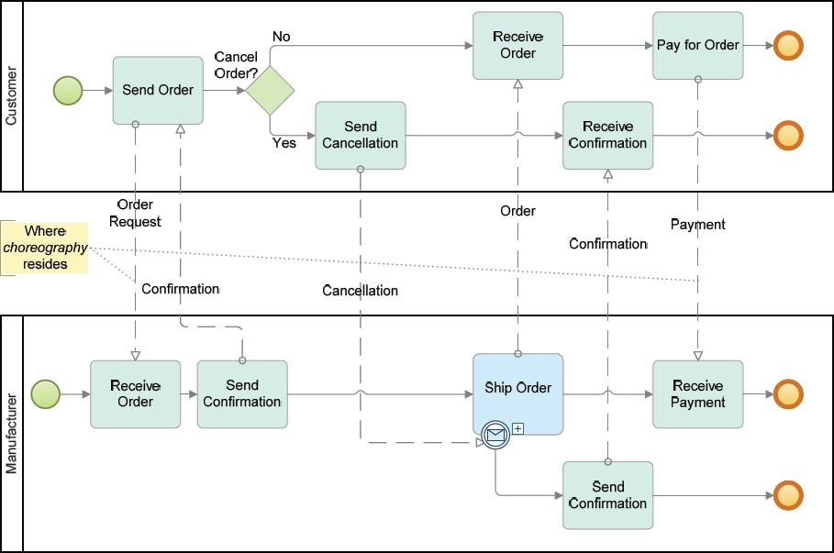
Choreography Example

Slide 12
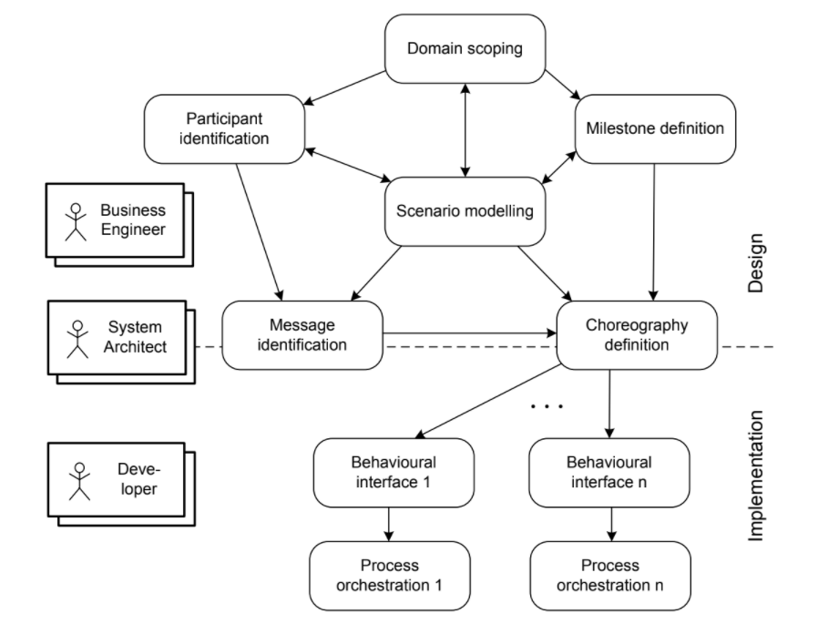
The phases involved in the development of process choreographies
There are three associated roles that represent the stakeholders involved in choreography design and implementation.

Slide 13
Business Engineers
Business engineers are mainly involved in the choreography design phases including:
scenario modelling--Plan
domain scoping--what users can and cannot access
milestone definition--Goals
participant identification
Business engineers are responsible for business-related aspects of the process choreography; they need to make sure that the collaboration contributes to the goals of the enterprise, similarly to organizational business processes.

Slide 14
System Architecture
System architects are responsible for the architectural aspects of the implemented process choreography.
System architects are at the border of design and implementation,

Slide 15
Process Choreography Design
High-level Structure Design:
High-level Behavioral Design:
Collaboration Scenarios:
Behavioral Interfaces:

Slide 16
Problem Statement
Auctioning brings together a seller and a buyer. The seller owns a certain good or offers a certain service. There are a number of potential buyers interested in the same item offered. The auctioning mechanism determines the actual buyer by allowing bidders (the potential buyers) to place bids. The auction has a predefined timeframe, e.g. several days. Only during the auction, the bidders are allowed to place their bids. The seller might define a minimum bid and there might be a fixed bidding increment depending on the currently highest bid and the policies of the auctioning service. Once the auction is over, the bidder who has placed the highest bid wins and follow-up activities such as payment and delivery are initiated.

Slide 17
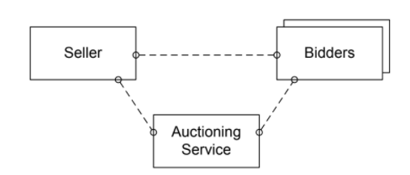
High-Level Design-Structural
High-level process choreography design involves structure design and behaviour design.
In high-level structure design, participant roles of the choreography are defined,

Slide 18
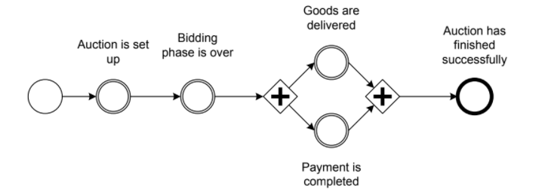
High-Level Design-Behaviour
High-level process choreography design involves structure design and behaviour design.
High-level behaviour design uses milestones that are achieved during the collaboration;
Each milestone represents a state in the overall collaboration that has a business meaning.
Initial Goal
Intermediate Goal
Ultimate Goal
milestones are defined by circles,
where the initial milestone has a single border.
the intermediate milestones have double borders, and the ultimate goal milestone has a bold border.

Slide 19
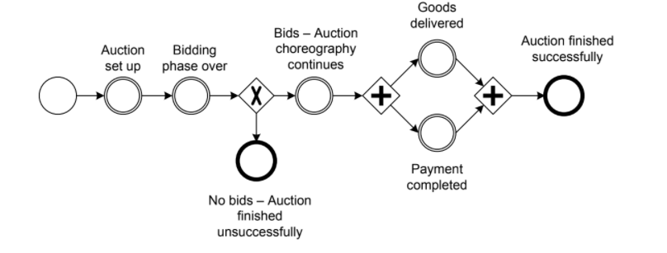
High-level behavioural model for bidding scenario, with different outcomes
if no single bid is placed during the auction. In this case, delivery and payment cannot
occur, and the conversation ends without the final goal being reached.

Slide 20
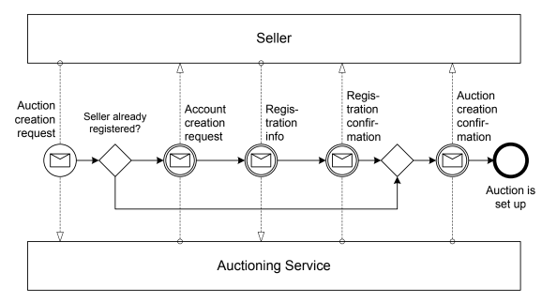
Collaboration Scenarios
In this phase, the interactions needed to proceed from one milestone to another are specified.
Interactions between process participants serve as the building blocks for the resulting collaboration scenarios.
Collaboration scenario: reaching milestones through interactions

Slide 21
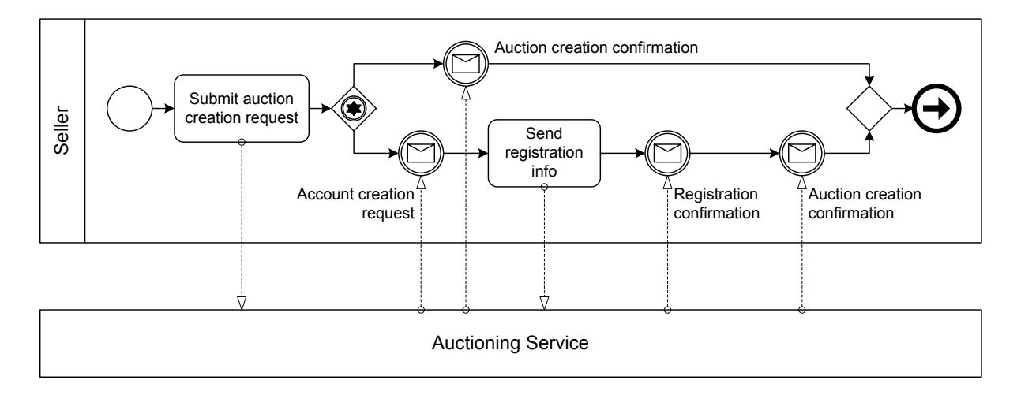
4. Behavioral interface for seller
A behavioural interface covers the individual view of one specific participant in the process choreography;
Behavioral interfaces consider parts of process orchestrations

Slide 22
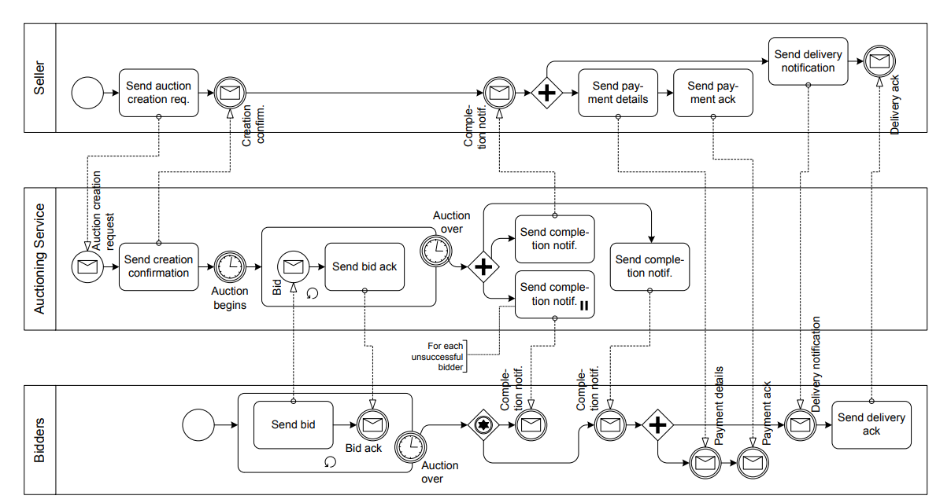
Summary- model for bidding scenario,
Behavioral-Interface of seller
Behavioral-Interface of Auction
Structural-Participant
Behavioral-Interface of Bidder
Behavioral-Participant

Slide 23
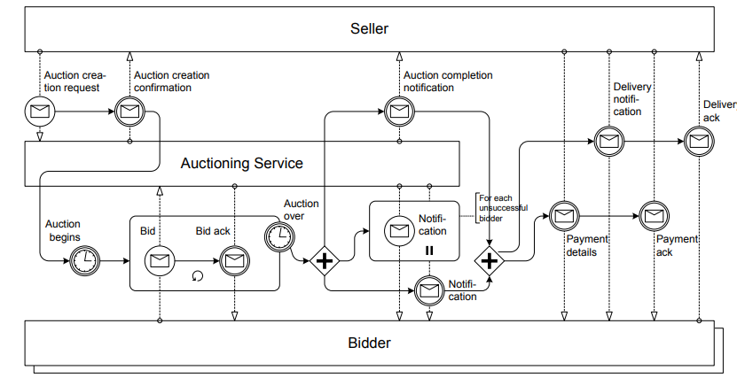
Interaction Model/collabration

Slide 24
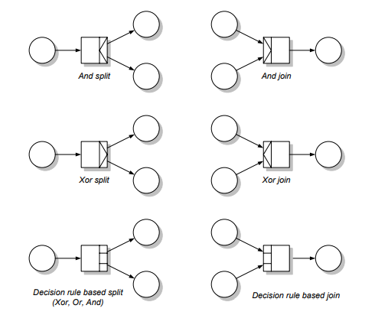

Slide 25
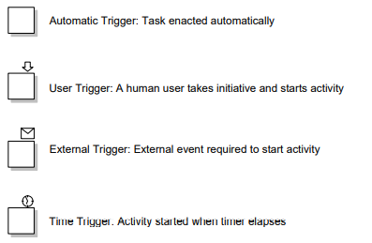

Slide 26
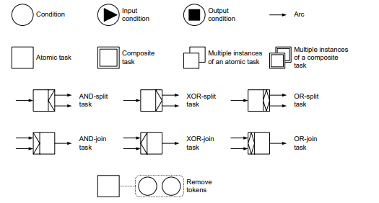

Slide 27
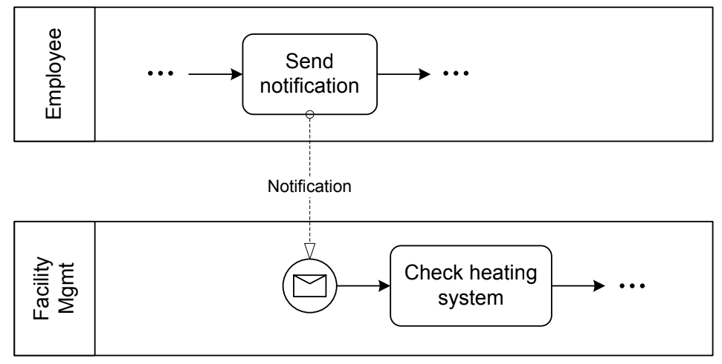
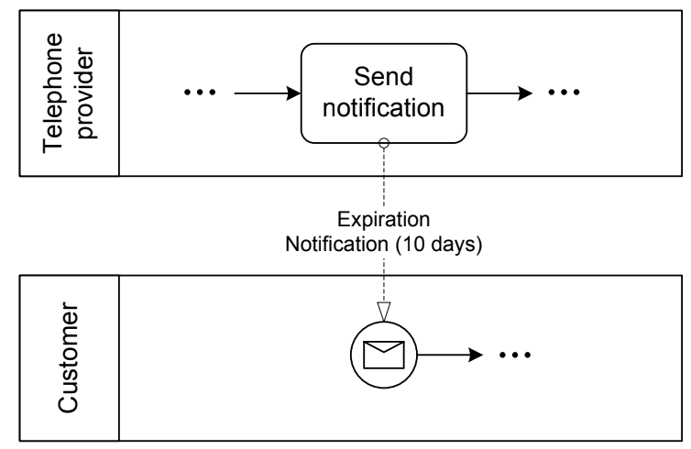
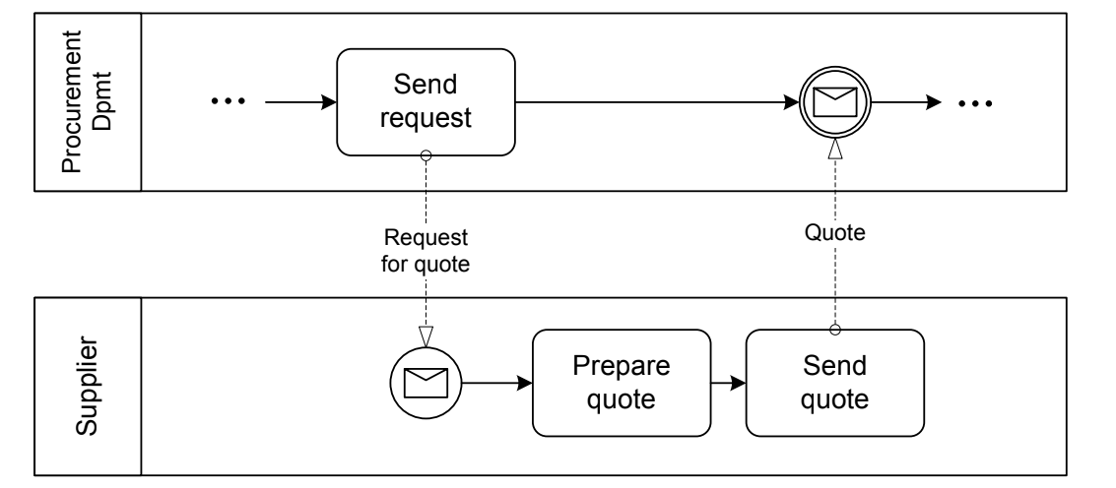
Service Interaction Patterns
Recive: from perspective of the Receiver.
Send: from perspective of the sender.
Send/Receive

Slide 28
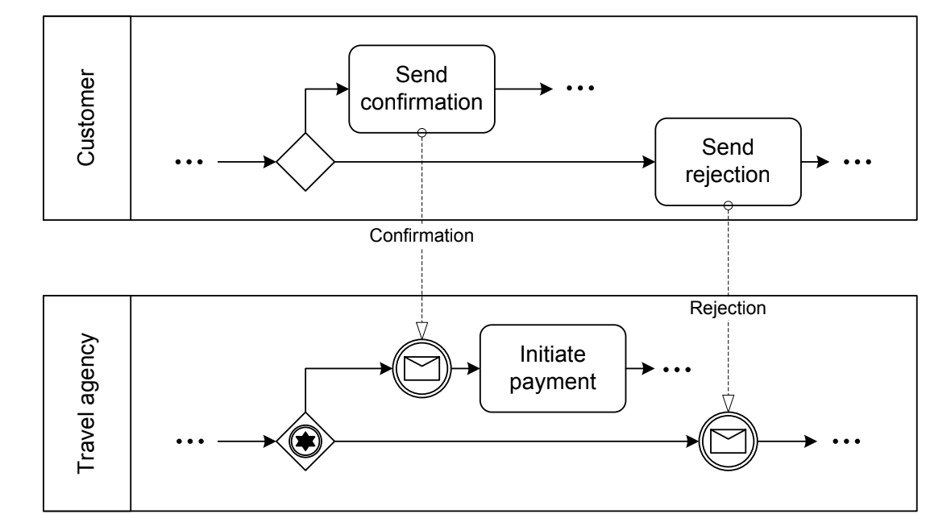
Racing Incoming Messages
Racing incoming messages are common in business-to-business scenarios; this pattern is described as follows: a participant is waiting for a message to arrive, but other participants have the chance to send a message. These messages by different participants “race” with each other. Only the first message arriving
will be processed.
Figure 5.21 shows a scenario where a travel agent has reserved a flight for
a customer, and now waits for a confirmation or a notification that the flight
details are not acceptable. In the case of confirmation the payment is initiated,
and in the case of rejection a new flight reservation might be needed.

Slide 29
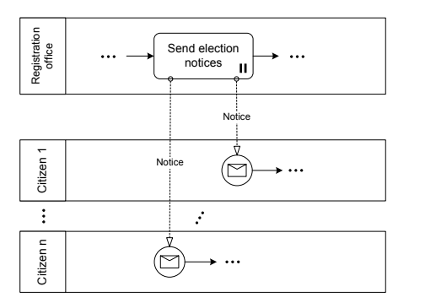
One-To-Many Send
A participant sends out several messages to other participants in parallel.

Slide 30
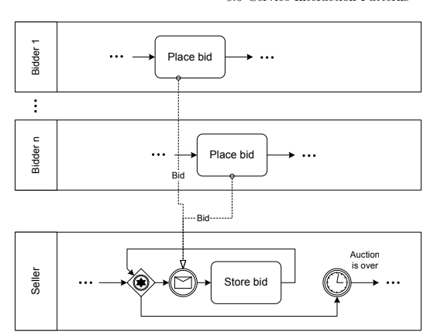
One-From-Many Receive
In the one-from-many receive pattern, messages can be received from many
participants. In

Slide 31
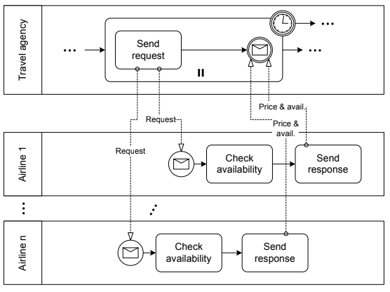
One-To-Many Send/Receive
A travel agency looks for the best offer for a flight on a certain route. The agent therefore initiates requests and the airlines give their prices and current
availability,

Slide 32
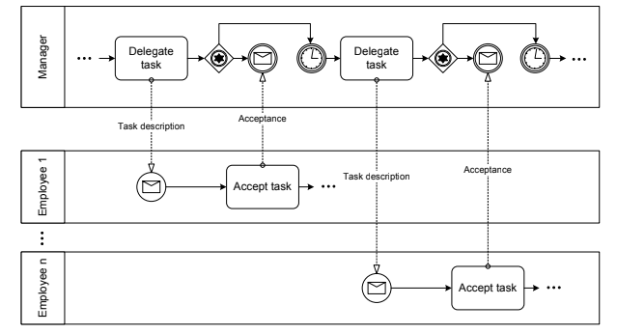
contingent requests patter
a participant sends a request to another
participant. If this participant does not answer within a given time, the request
is sent to a second participant. Again, if no response comes back, a third
participant is contacted, and so on. Delayed responses, i.e., responses arriving
after the time-out has already occurred, might or might not be discarded.

